Slide 1



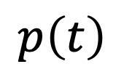

Iwasa et al.
Fig. 1
heat stress
$$h\left(t\right)$$
BVOC
production
photosynthesis
$$s\left(t\right)$$
$$λ\left(t\right)$$
$$p\left(t\right)$$
$$b\left(t\right)$$
effectiveness

Slide 2
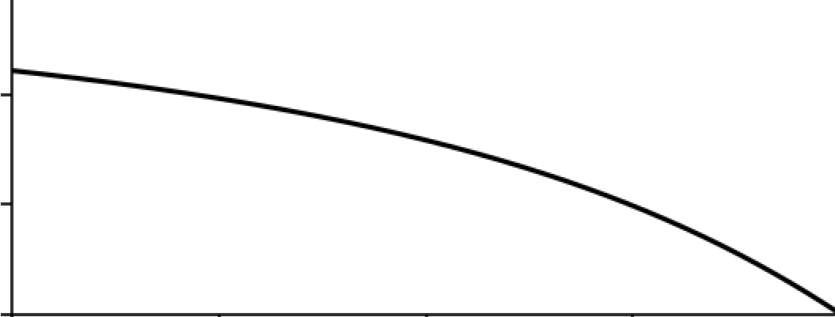
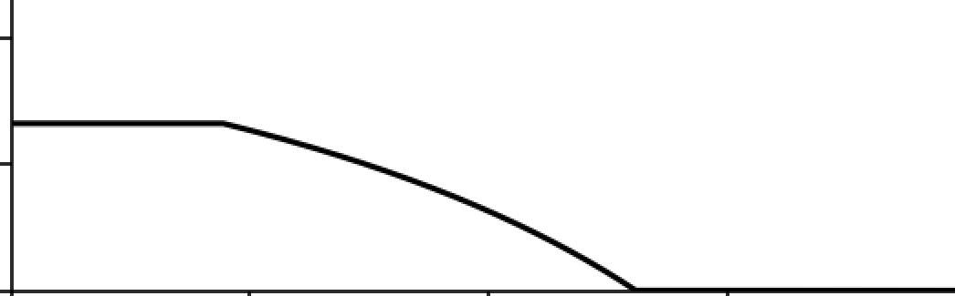











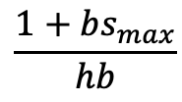








Iwasa et al.
Fig. 2
$$\frac{1+bs_{max}}{hb}$$
marginal value
of leaf area
$$λ\left(t\right)$$
$$0.4$$
$$λ\left(t\right)$$
$$\frac{1}{hb}$$
$$0.2$$
$$λ\left(t\right)$$
$$0$$
$$t_{f}$$
$$0$$
$$t$$
$$t_{s}$$
$$T$$
$$0.2$$
$$s_{max}$$
investment in
BVOC production
$$0.1$$
$$s\left(t\right)$$
$$0$$
$$t_{f}$$
$$t_{s}$$
$$0$$
$$t$$
$$T$$

Slide 3
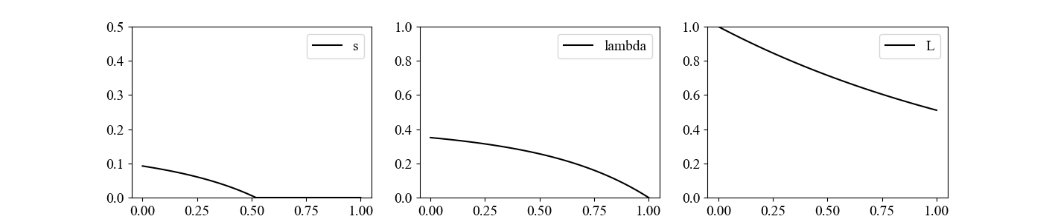
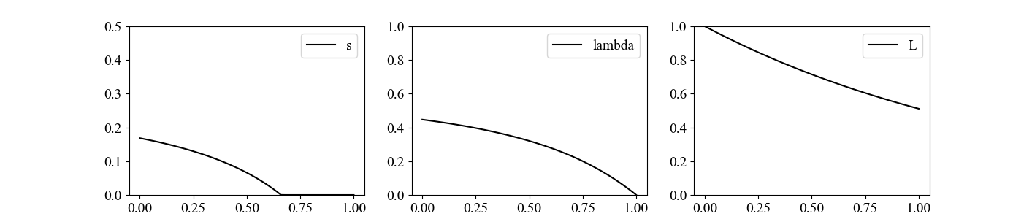
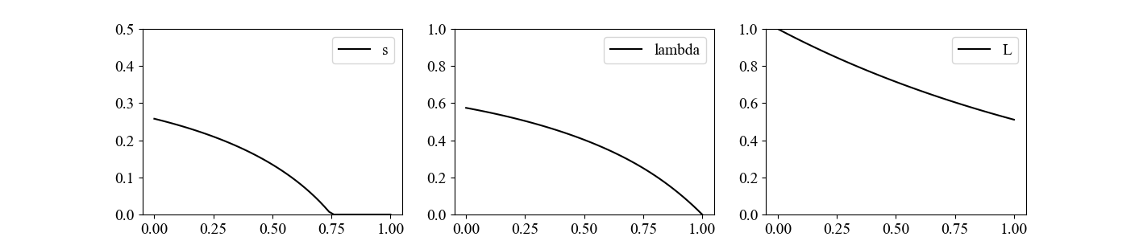














Iwasa et al.
Fig. 3(a)(b)(c)
(a)
(b)
(c)
$$s\left(t\right)$$
$$p=0.8$$
$$s\left(t\right)$$
$$h=1.6$$
$$s\left(t\right)$$
$$b=1.6$$
$$p=1$$
$$h=2$$
$$b=2$$
BVOC production
$$p=1.25$$
$$h=2.5$$
$$b=2.5$$
time
$$t$$
time
$$t$$
time
$$t$$

Slide 4










Iwasa et al.
Fig. 3(d)(e)
(d)
(e)
(c)
$$s\left(t\right)$$
$$u=0.00008$$
$$s\left(t\right)$$
$$h=1.6$$
$$b=1.6$$
$$T=1$$
$$u=0.0001$$
$$T=0.8$$
$$b=2$$
$$h=2$$
BVOC production
$$u=0.00012$$
$$T=0.6$$
$$h=2.5$$
$$b=2.5$$
time
$$t$$
time
$$t$$

Slide 5
effect of enhanced $x$ on the change in
$$y=s\left(0\right)$$
$$e_{yx}=\frac{\log{y_{2}}−\log{y_{1}}}{\log{x_{2}}−\log{x_{1}}}$$
elasticity
$$p$$ | $$h$$ | $$b$$ | $$u$$ | $$T$$
$$1.95$$ | $$0.657$$ | $$0.955$$ | $$−8.25$$ | $$0.646$$
positive
positive
positive
negative
positive

Slide 6
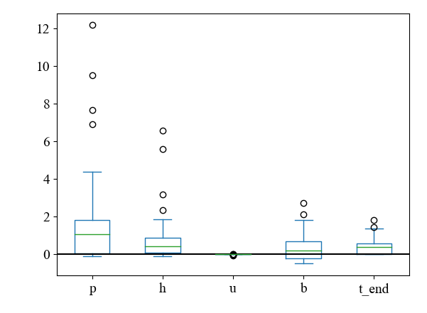

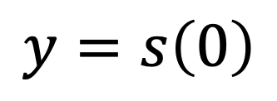




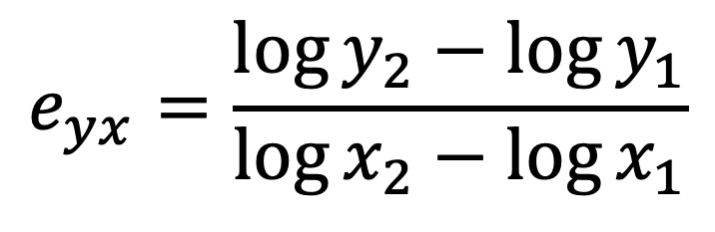

effect of enhanced $x$ on the change in
$$y=s\left(0\right)$$
$$e_{yx}=\frac{\log{y_{2}}−\log{y_{1}}}{\log{x_{2}}−\log{x_{1}}}$$
elasticity
$$p$$
$$h$$
$$u$$
$$b$$
$$T$$

Slide 7
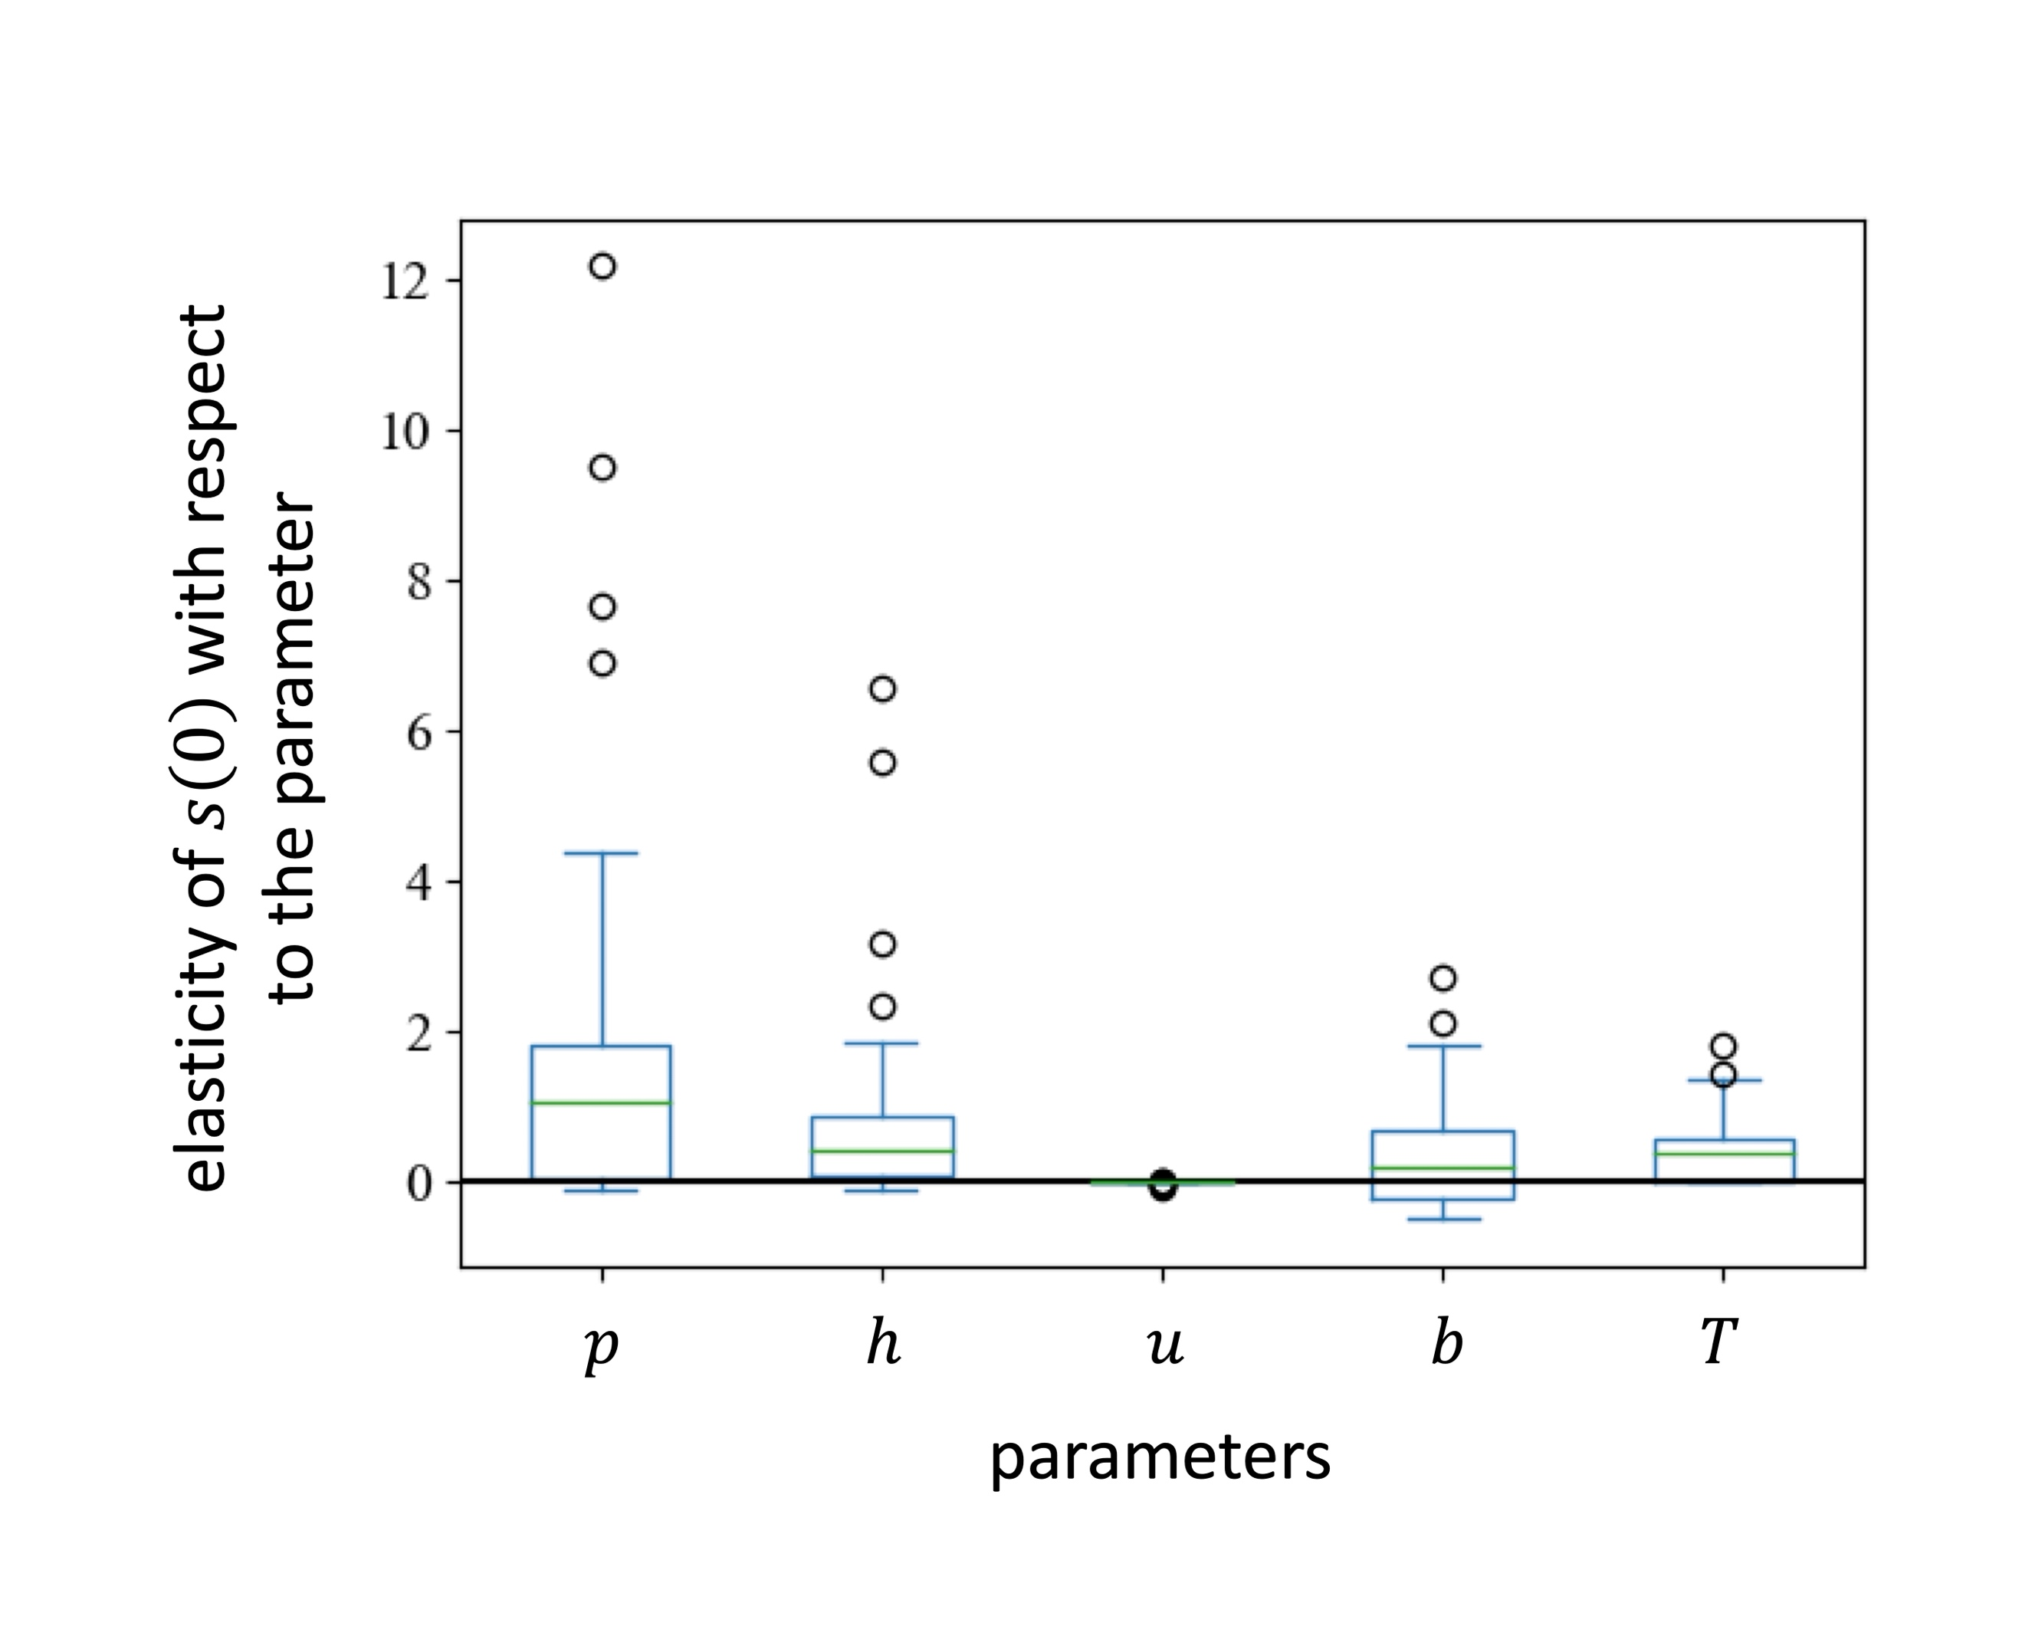
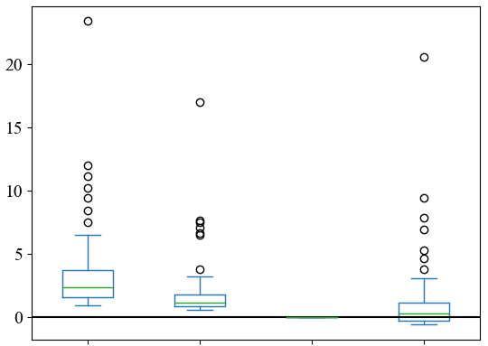




$$p$$
$$h$$
$$u$$
$$b$$

Slide 8
Caption of elastisity
Any parameter has a positive effect on s(0). In particular, p has a strong influence. u has a small influence because of the small value of the parameter.
Pは0から2、hは0から4、uは0から1、bは0から4、Tは0から1の範囲でランダムに選び、シミュレーションを100回行った。解を持たない場合はデータから外した。得られたデータは80くらいだった。
P was randomly selected from 0 to 2, h from 0 to 4, u from 0 to 1, b from 0 to 4, and T from 0 to 1, and the simulation was performed 100 times. If there was no solution, it was removed from the data. The data obtained was about 80.

Slide 9
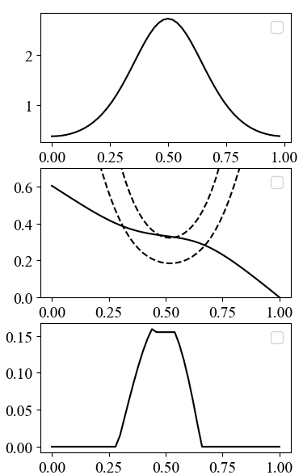








Iwasa et al.
Fig. 4
$$h\left(t\right)$$
heat stress
$$\frac{1+b\left(t\right)s_{max}}{h\left(t\right)b\left(t\right)}$$
$$λ\left(t\right)$$
marginal value
of leaf area
$$\frac{1}{h\left(t\right)b\left(t\right)}$$
$$s_{max}$$
$$s\left(t\right)$$
BVOC
production
$$t$$
$$T$$
Notes:
t刻み幅を小さくして計算する。

Slide 10
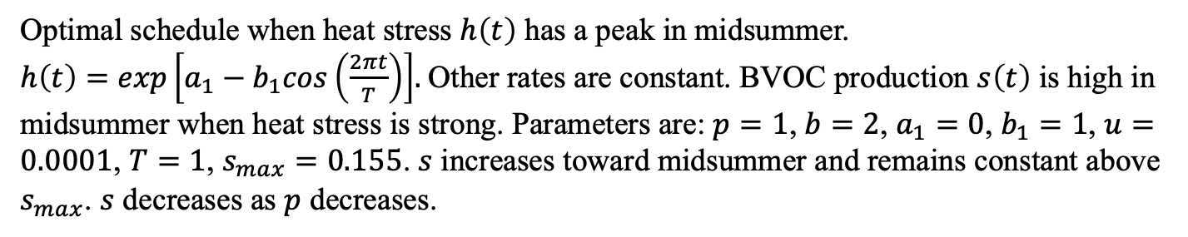
Caption of Fig4
Optimal schedule when heat stress $h\left(t\right)$ has a peak in midsummer. $h\left(t\right)=exp\left[a_{1}−b_{1}cos\left(\frac{2πt}{T}\right)\right]$. Other rates are constant. BVOC production $s\left(t\right)$ is high in midsummer when heat stress is strong. Parameters are: $p=1$, $b=2$, $a_{1}=0$, $b_{1}=1$, $u=0.0001$, $T=1$, $s_{max}=0.155$. $s$ increases toward midsummer and remains constant above $s_{max}$. $s$ decreases as $p$ decreases.

Slide 11
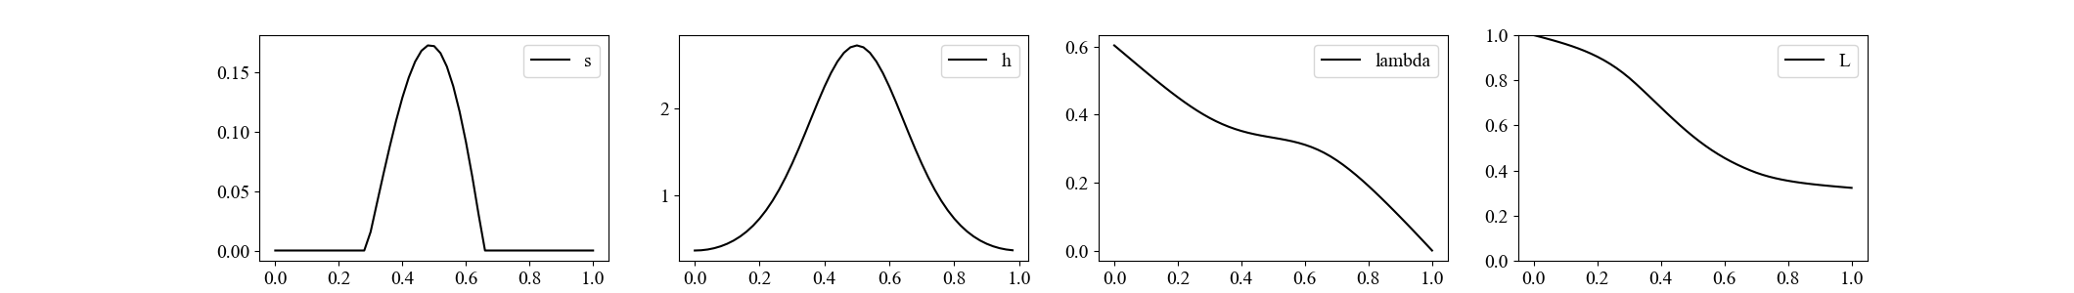
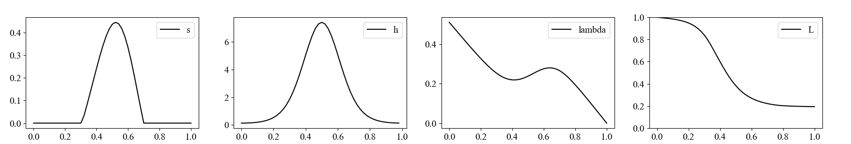
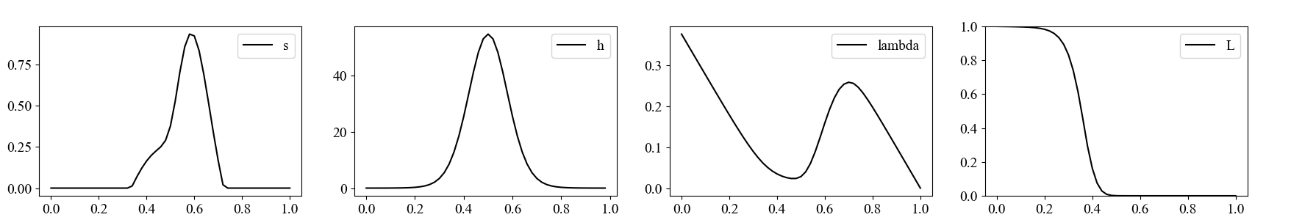









Iwasa et al.
Fig. 5
BVOC production
heat stress
marginal value
leaf area
$$s\left(t\right)$$
$$h\left(t\right)$$
$$λ\left(t\right)$$
$$L\left(t\right)$$
$${ b}_{1}=1$$
$$b_{1}=2$$
$$b_{1}=4$$
$$t$$
$$t$$
$$t$$
$$t$$

Slide 12
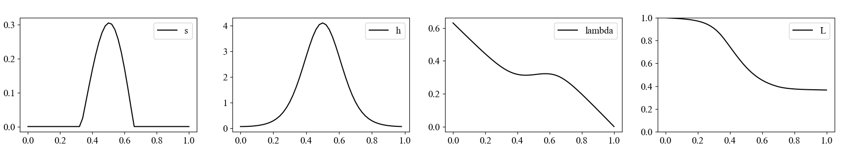
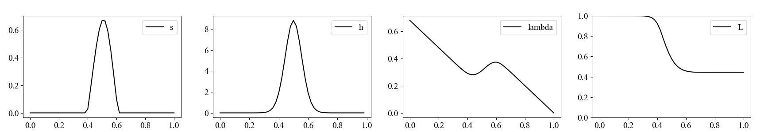











Iwasa et al.
Fig. 6
BVOC production
heat stress
marginal value
leaf area
$$s\left(t\right)$$
$$h\left(t\right)$$
$$λ\left(t\right)$$
$$L\left(t\right)$$
$$a_{1}=0,$$
$${ b}_{1}=1$$
$$a_{1}=−0.588,$$
$${ b}_{1}=2$$
$$a_{1}=−5.822,$$
$${ b}_{1}=8$$
$$t$$
$$t$$
$$t$$
$$t$$

Slide 13
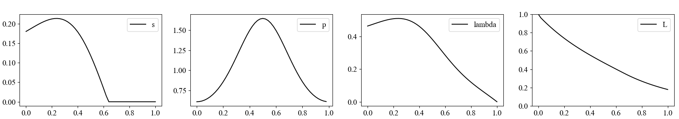







Iwasa et al.
Fig. 7
BVOC production
Photosynthesis
marginal value
leaf area
$$s\left(t\right)$$
$$p\left(t\right)$$
$$λ\left(t\right)$$
$$L\left(t\right)$$
$$t$$
$$t$$
$$t$$
$$t$$

Slide 14
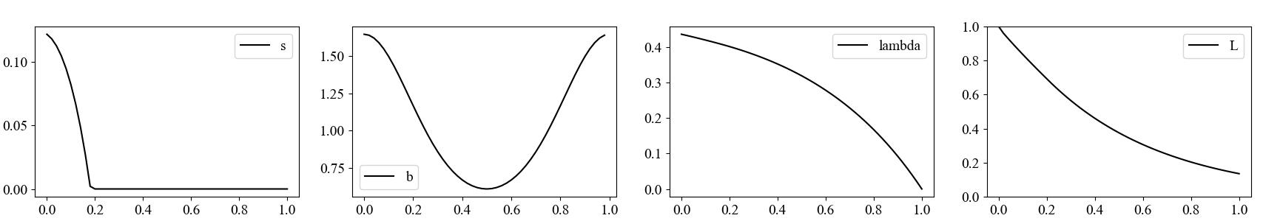







Iwasa et al.
Fig. 8
BVOC production
Photosynthesis
marginal value
leaf area
$$s\left(t\right)$$
$$b\left(t\right)$$
$$λ\left(t\right)$$
$$L\left(t\right)$$
$$t$$
$$t$$
$$t$$
$$t$$

